Slide 1
AE Cloud2 Arduino Firmeware with SHT31 (Use Grove Port)
By Michael Li 4/1/2019

Slide 2
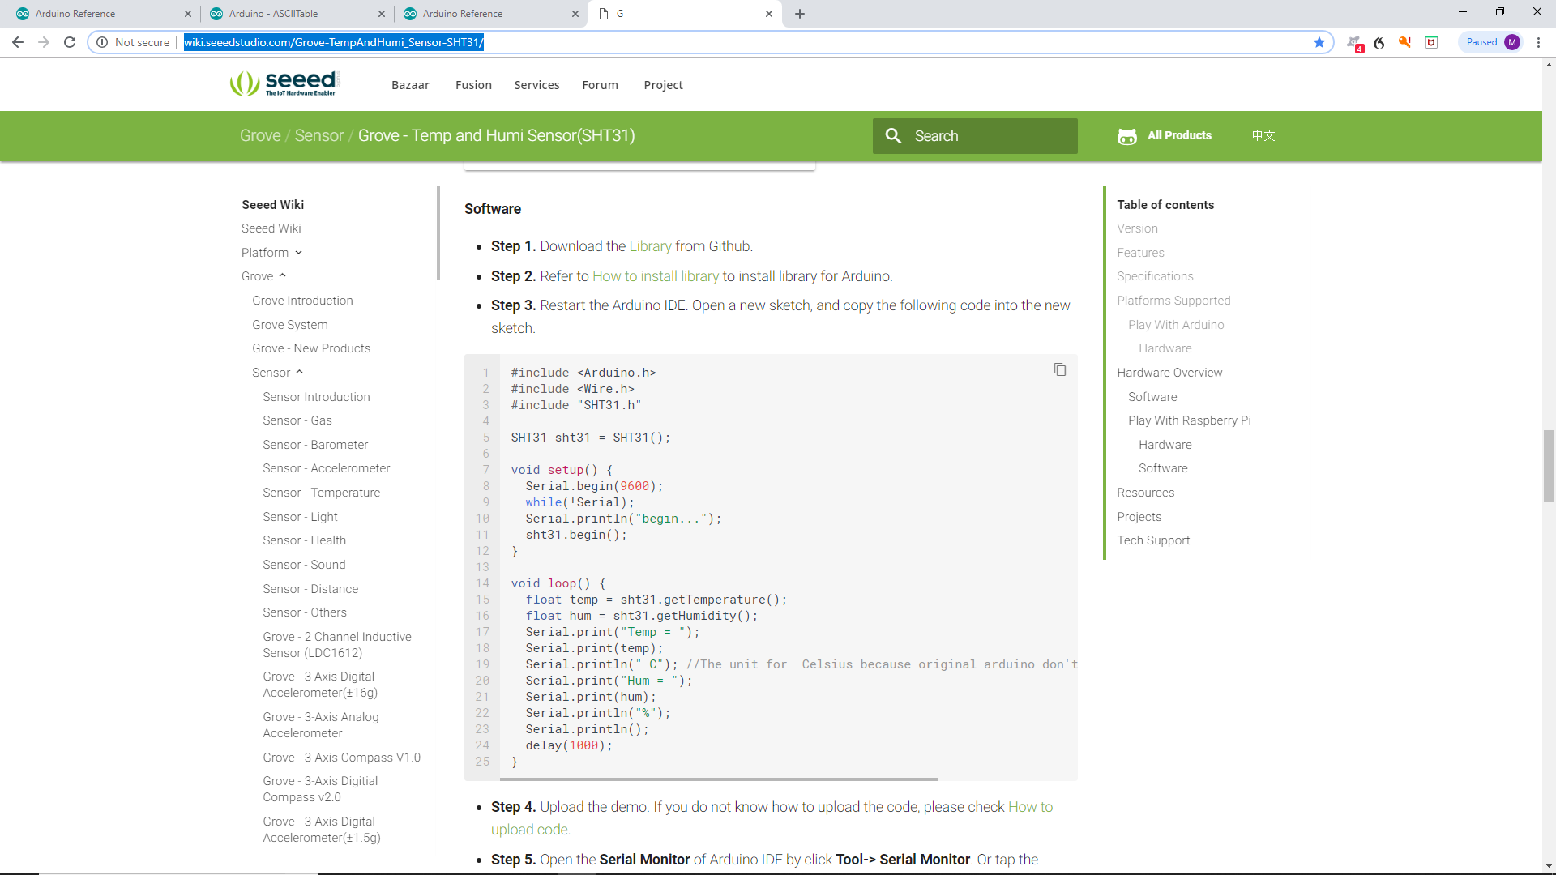
http://wiki.seeedstudio.com/Grove-TempAndHumi_Sensor-SHT31/
Copy the new sketch ino file and SHT31.h/cpp files.

Slide 3
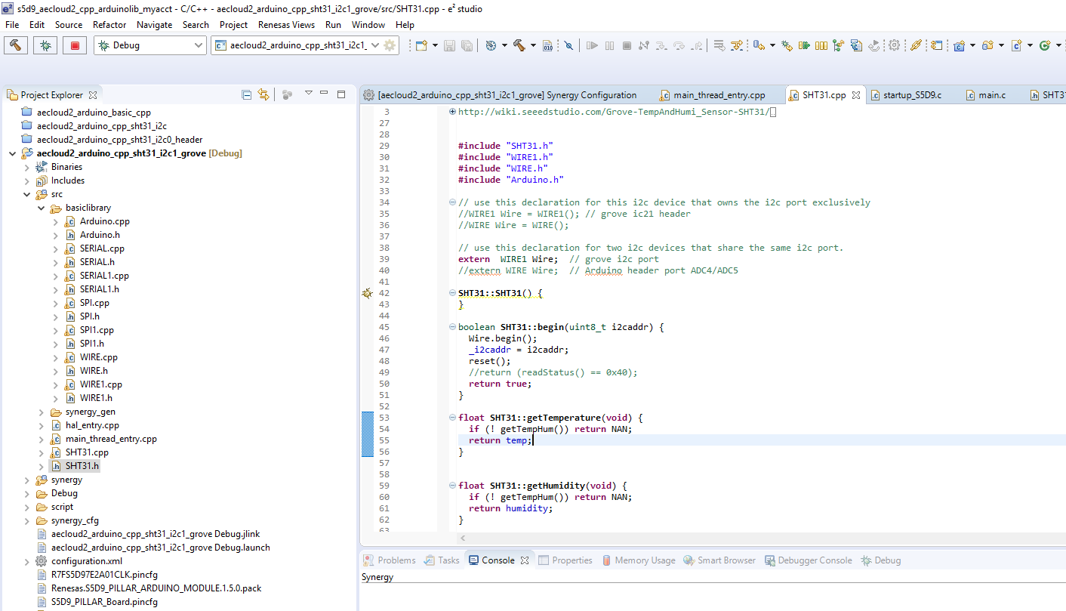
Copy SHT31.h/cpp to SRC folder and add some headers/class objects.

Slide 4
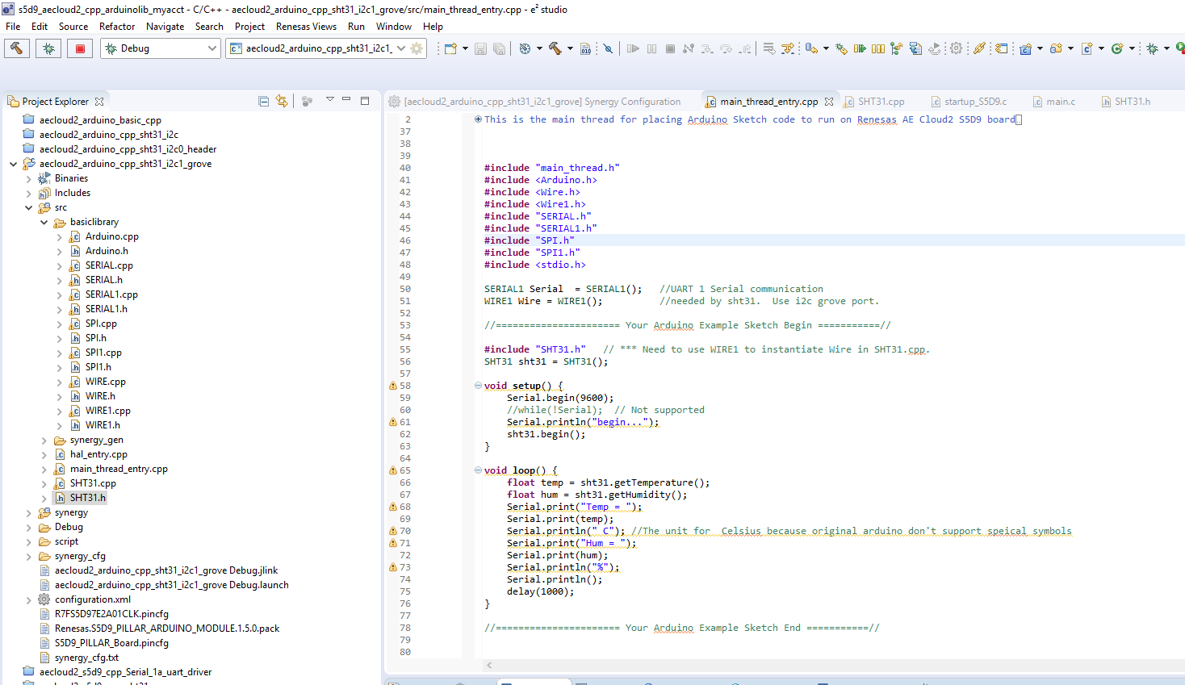
Main Thread : the example INO code.

Slide 5
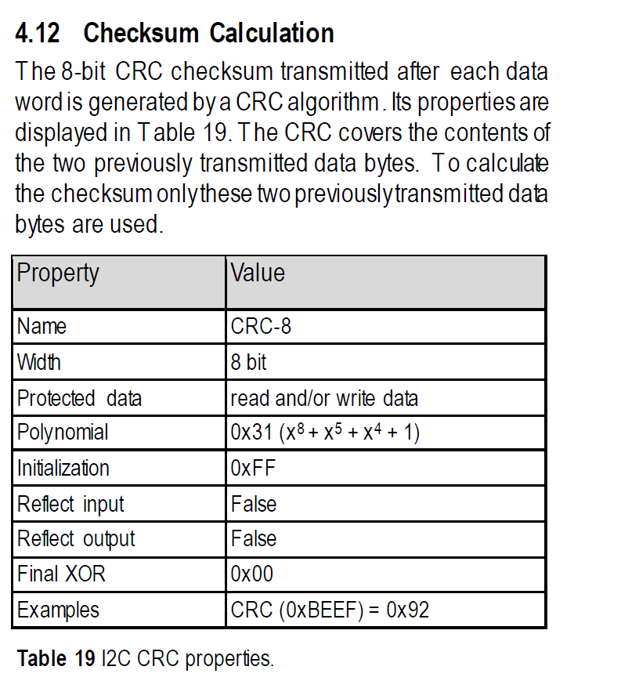
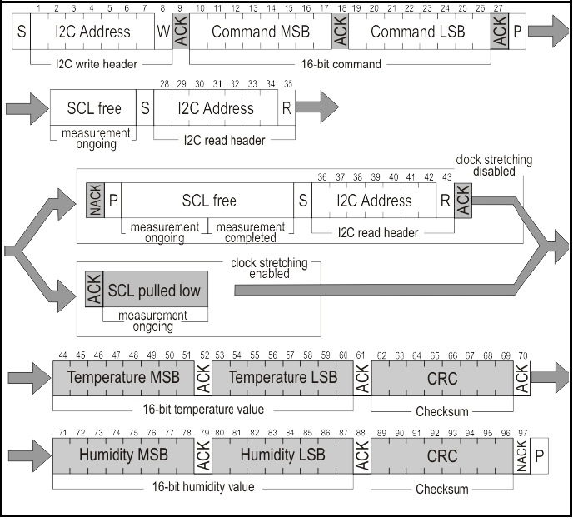
Added CRC8 Verification for Temperature and Humidity Data to SHT31.cpp

Slide 6
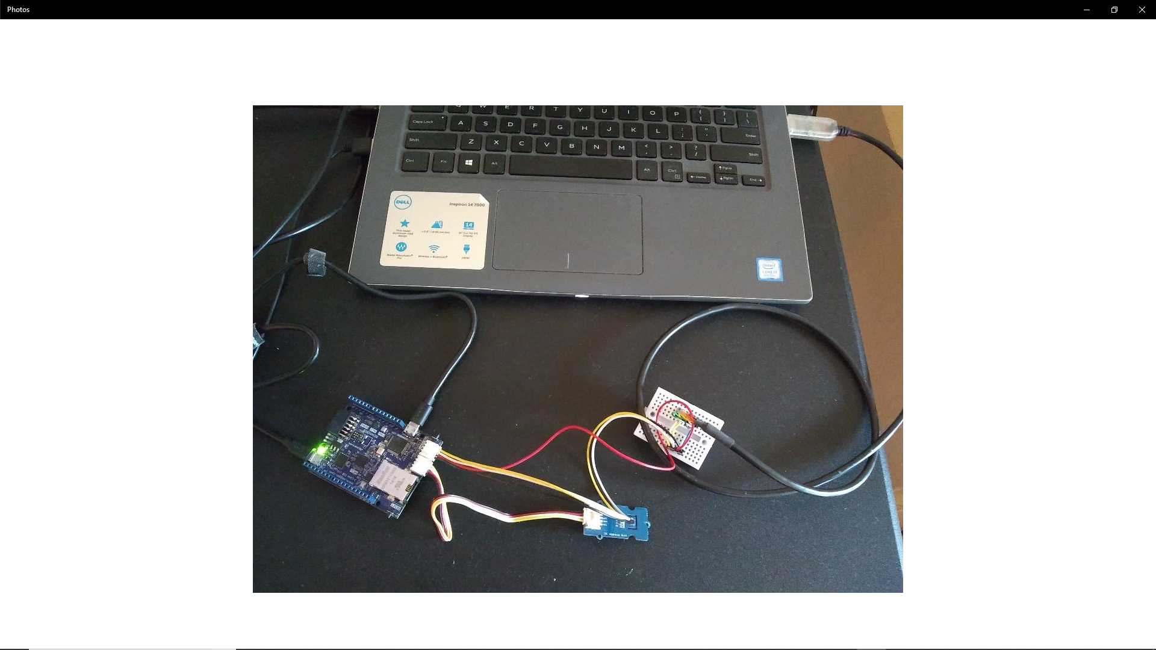
Hardware Setup

Slide 7
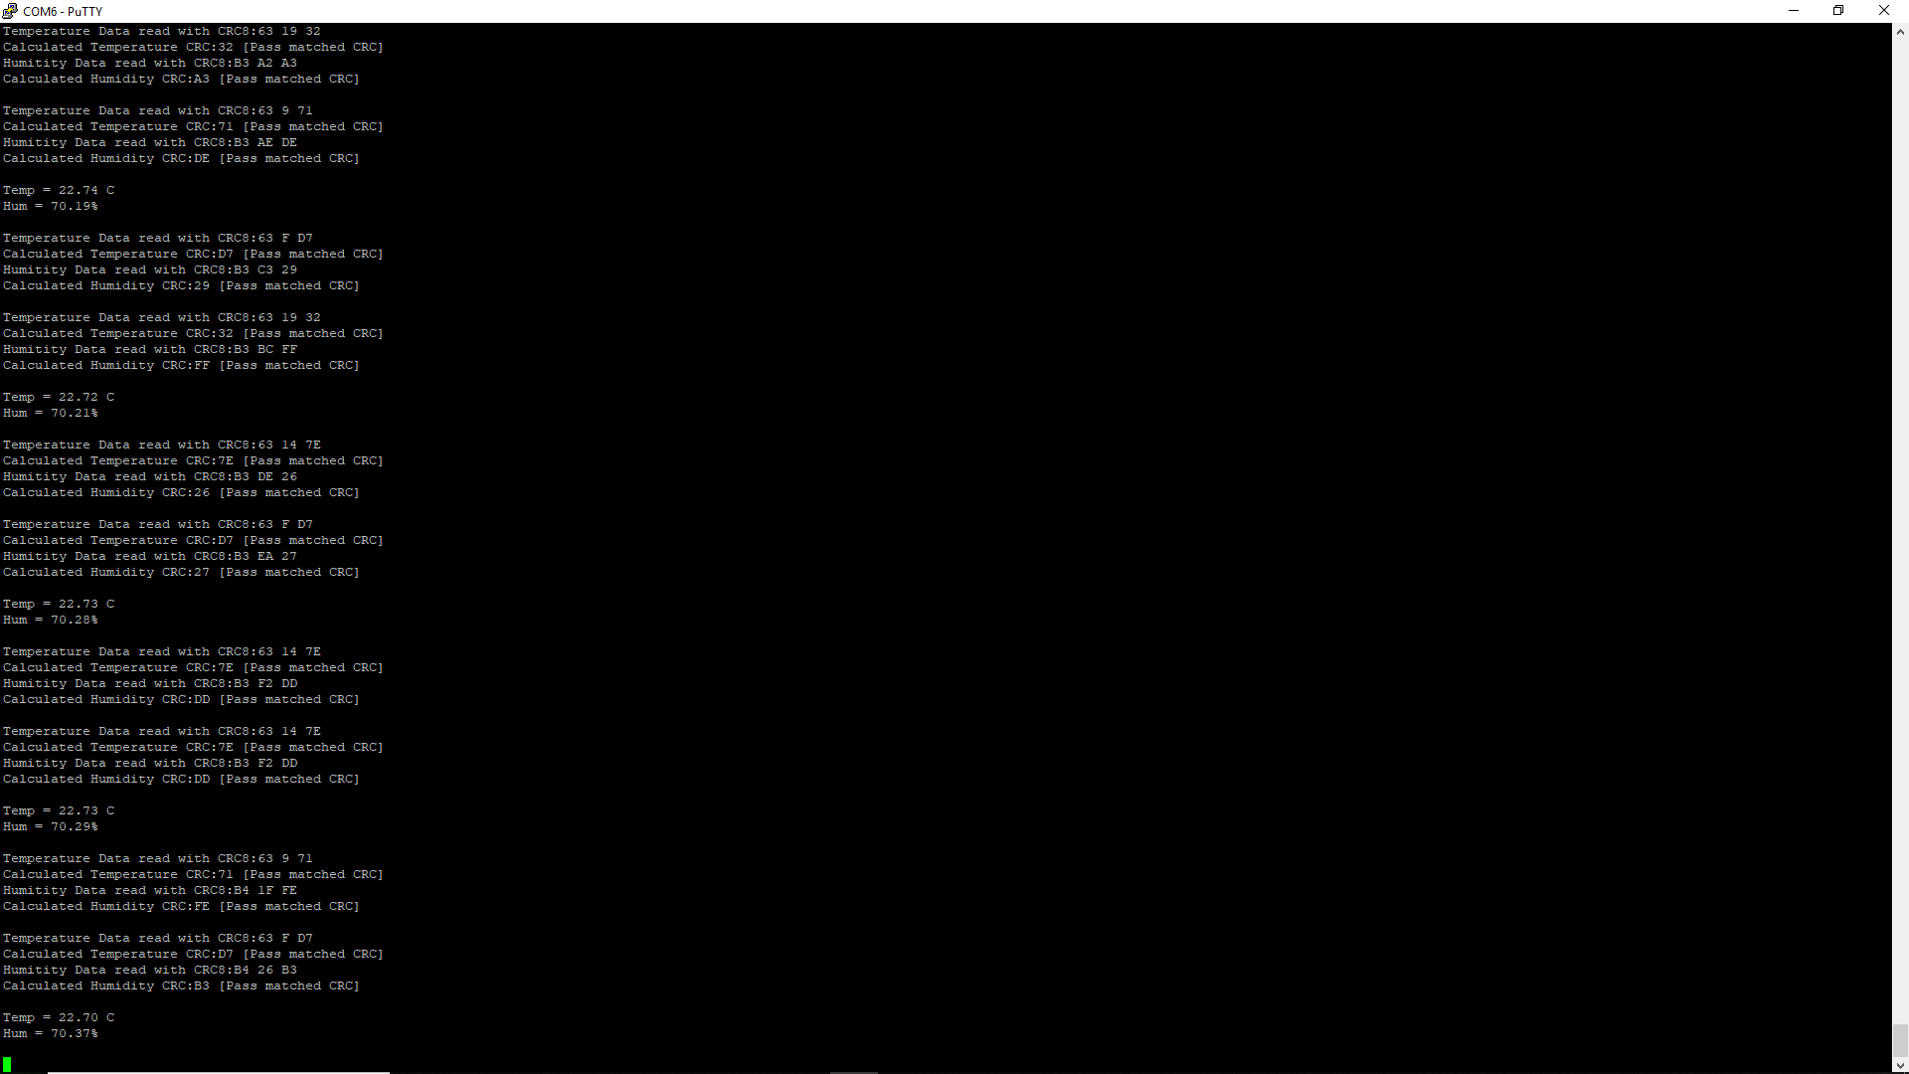
Terminal (Serial) Putty.

